Slide 1
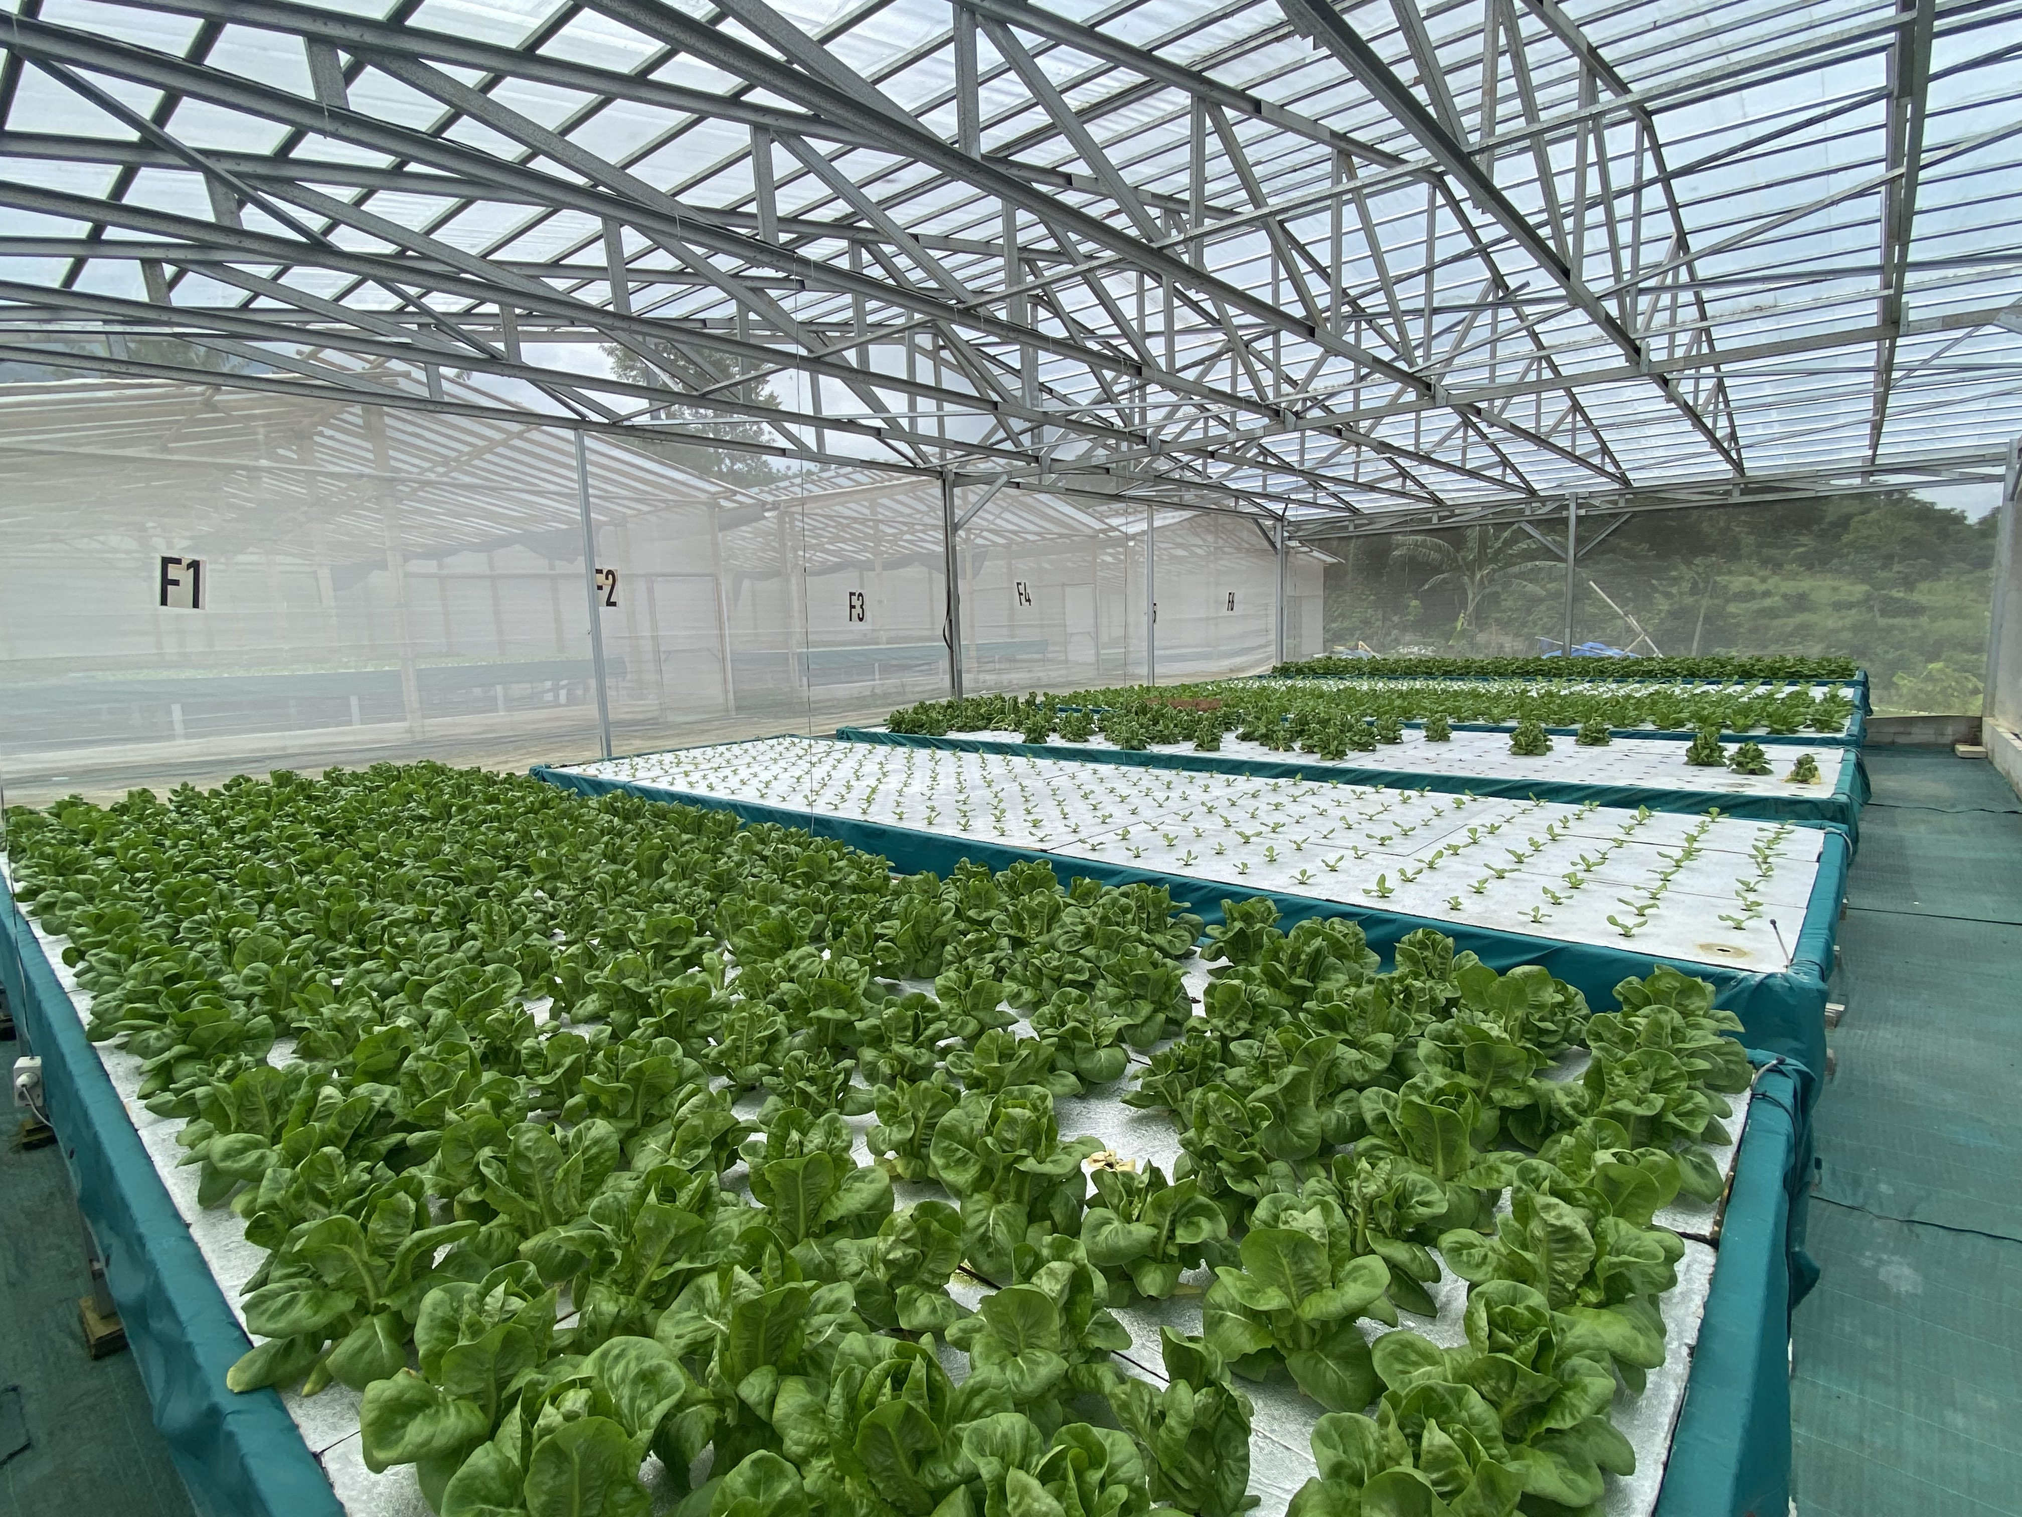

IOT ENABLED HYDROPONIC FARM MONITORING
PRE-THESIS PRE-DEFENSE
18 JULY 2023
JASON ALEXANDER 2440042310
Notes:
Good afternoon, everyone!
<Greet individually.>
You invited me today to present my thesis pre-defense.
My thesis is a case study about IOT Enabled Hydroponic Farm Monitoring.
Before we start, if you have any questions during my presentation, please feel free to interrupt me, because the best questions are the fresh questions.
Alright, let’s get straight to it!

Slide 2
Table of Contents
General Summary of this Presentation’s Chapters (5 Chapters)
Introduction
Objectives
Solution
Scope
What Comes Next
This chapter provides a general overview on what this case study is about.
It also covers a short analysis of the problems currently faced by Just Hydroponics.
This chapter covers the research questions of the case study.
It also covers the aims and benefits of the case study.
This chapter delivers a general overview of what the proposed solution is.
It covers the main components that make up the solution.
This chapter explains the limitations of this case study.
It covers what are strictly included and what are not within this case study.
This chapter will explain about my plans for the second semester of my thesis writing.
Notes:
This presentation consists of five chapters.
The first chapter, Introduction, will provide a general overview on this case study, and also, give a brief analysis on the problems faced by the company which is the subject of this case study, Just Hydroponics.
The second chapter, Objectives, will cover the research questions and aims and benefits of my case study.
The third chapter, Solution, will give a preview of what the proposed solution is, it also covers the primary components of the solution design.
The fourth chapter, Scope, declares the limitations of this case study. Because, after all, I’m just a single person with a limited and specialized skillset. Even though I’d love to, bringing this case study to perfection will require skills that I don’t have. Therefor I have to declare a scope.
The fifth and final chapter, will discuss what comes after this pre-defense.

Slide 3

Introduction
01
Background – Company Profile - Current Process
Notes:
Let’s begin with the first chapter, which is Introduction!
It will cover the background, company profile, and current processes.

Slide 4
Background
Ever-increasing population increases strain on agriculture. This creates a need for a faster and more efficient food production.
Several practices has been developed to tackle this problem. Hydroponics is one of them. It offers faster growth rates and higher yields.
Unfortunately, compared to conventional methods, hydroponics is more difficult to get right due to their high sensitivity to environmental factors.
Fortunately, advancements in IoT, cloud, and sensor technologies has made it easier and cheaper than ever to devise a solution.
Combining these technologies can lead to the creation of a truly powerful solution.
Notes:
Let’s begin with the background.
Human population continues to rise, and with it comes with an ever-increasing demand for food.
This creates a need for faster and more efficient ways to produce food.
Of course, have developed several practices to do this. And Hydroponics is one of them.
Unfortunately, hydroponics is relatively difficult to use compared to more conventional methods.
Fortunately, there are technology that can be leveraged to offset this difficulty.

Slide 5
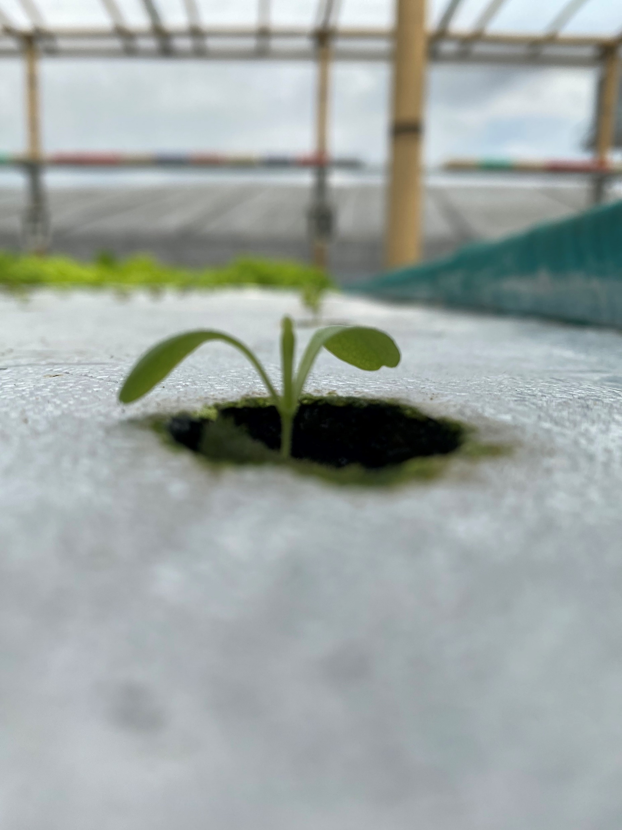
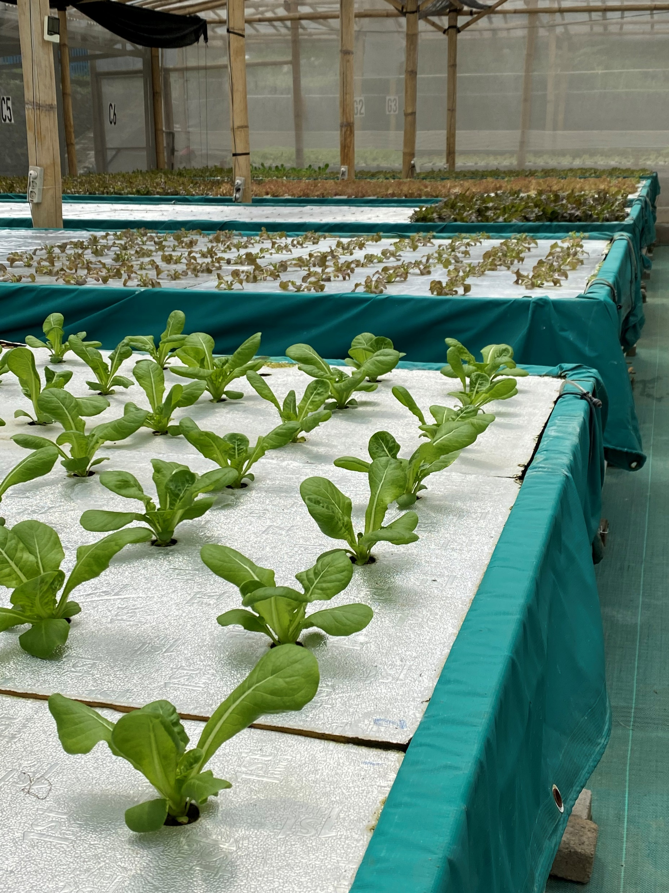
Company Profile
Just Hydroponics
Notes:
Continuing onto Company Profile.
So, this is the company… Just Hydroponics….
<Free explain.>

Slide 6
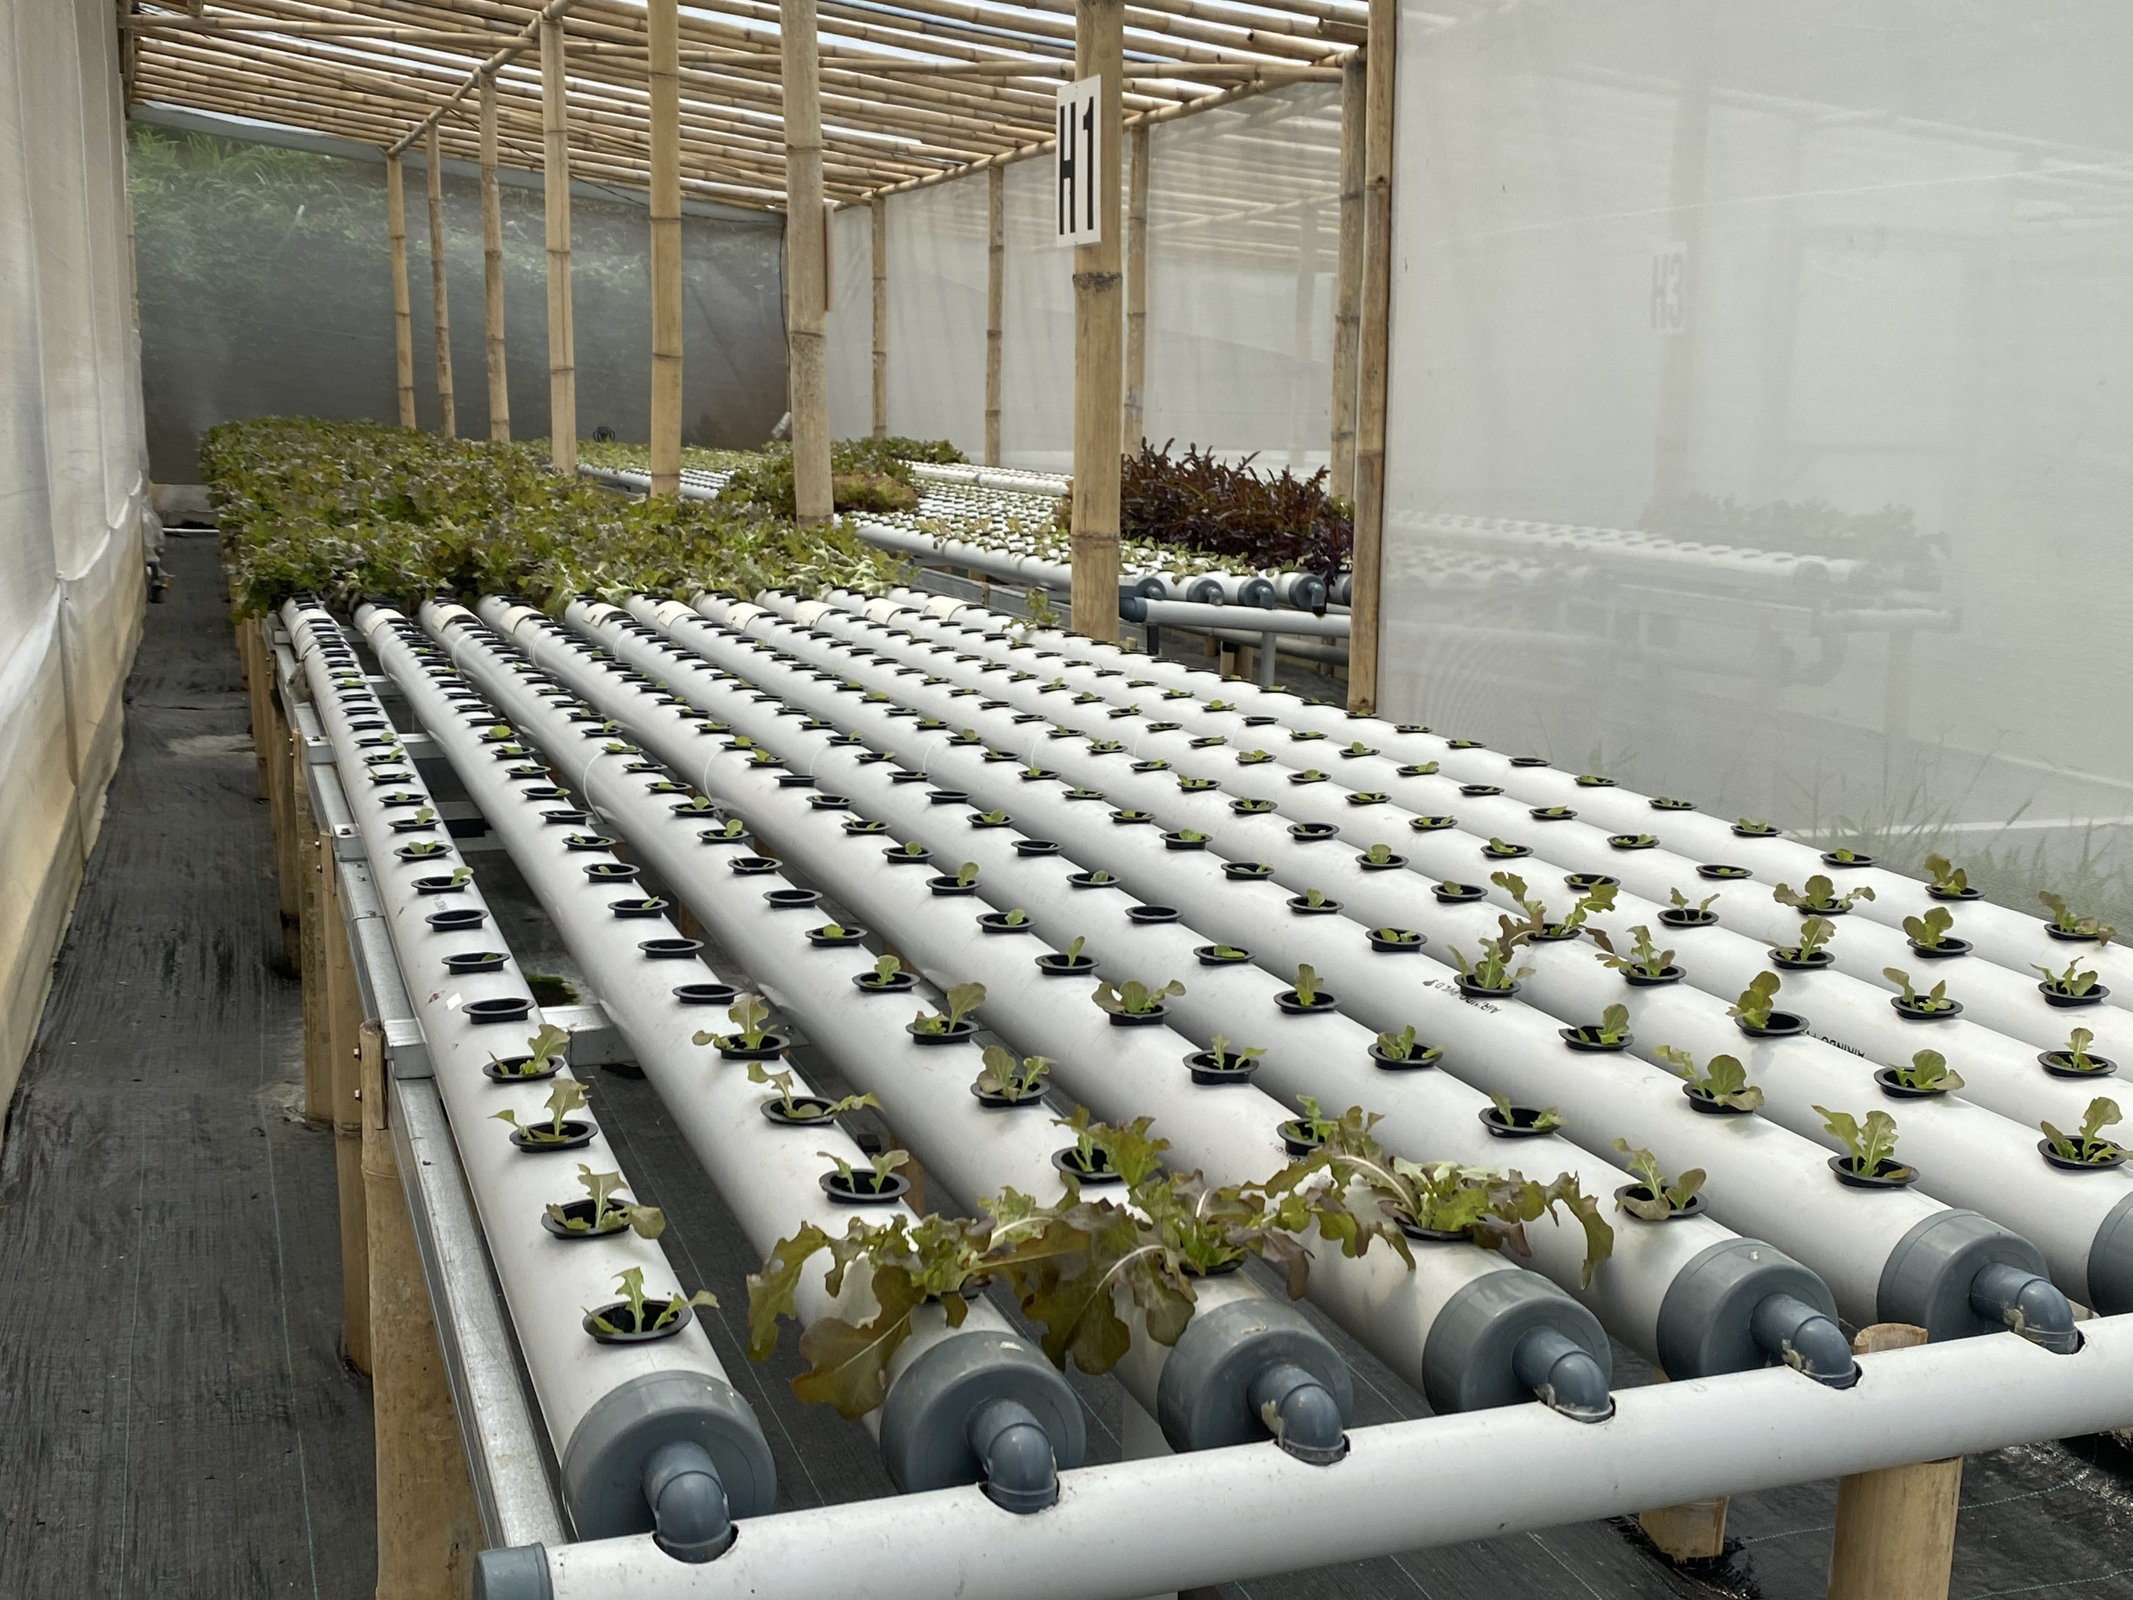
Company Profile
Just Hydroponics
Family-owned company.
Located in the outskirts of Bogor.
Medium-sized farm with around a dozen lots. Plans for further expansion.
Employs a few staff members. Mostly locals, blue-collar, little formal education background.
Notes:
So Just Hydroponics is a family-owned company.
The farm is located on the outskirts of Bogor.
I’d describe them as a medium-sized farm.
They have around a dozen lots, with a dozen or so employees.
The farm is located on land which they fully own. The land is relatively large, and they are currently only using a small portion of it.

Slide 7
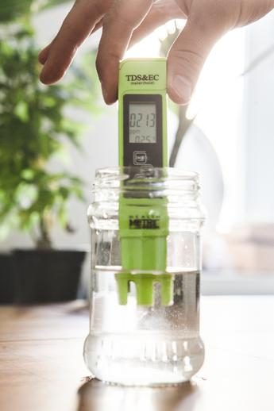
Current Process
Method of Data Collection
The method of data collection currently utilized by Just Hydroponics is manual and scattered.
Data is collected once a day.
Data collected manually, using hand-held tools.
No set standard for the measuring tool. There are a variety of brands in their inventory.
Different brands and manufacturers will have varying tolerances. This compromises data consistency.
A standardized, consistent, and more frequent method of data collection is needed.
Notes:
Let’s see their method of data collection.
[SECOND POINT]
-> This is a problem because collecting data once a day means that should there be alarming changes to the hydroponic environment, by the time the issue is found out, it’ll be too late and the damage will have already be done.
[THIRD POINT]
-> As you can see on the illustration on the right.
-> It’s important to note that this is not my image, it’s an image I got off of Google Image, but it’s basically the same tool currently used by Just Hydroponics.
-> It’s a cheap tool, called “TDS and EC Meter”, and it’s around IDR 30k in Tokopedia.
[FOURTH POINT]
-> What do I mean by this?
-> The illustration on the right is the most numerous tool that they have, but they have other brands of tools, in much smaller numbers of course, but are still in use.

Slide 8
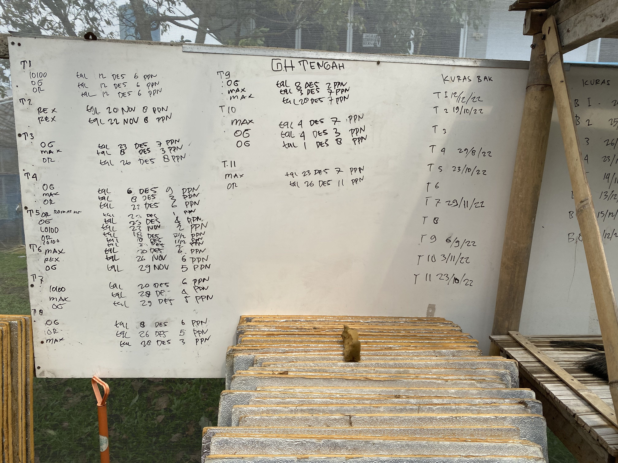
Current Process
Method of Data Storage
Currently, they store their data on whiteboards.
A practical and pragmatic approach, but with apparent drawbacks.
A small amount of rainwater or an accidental wipe will delete the data beyond recovery.
A better method of data storage is needed.
Notes:
Let’s discuss their method of data storage.

Slide 9
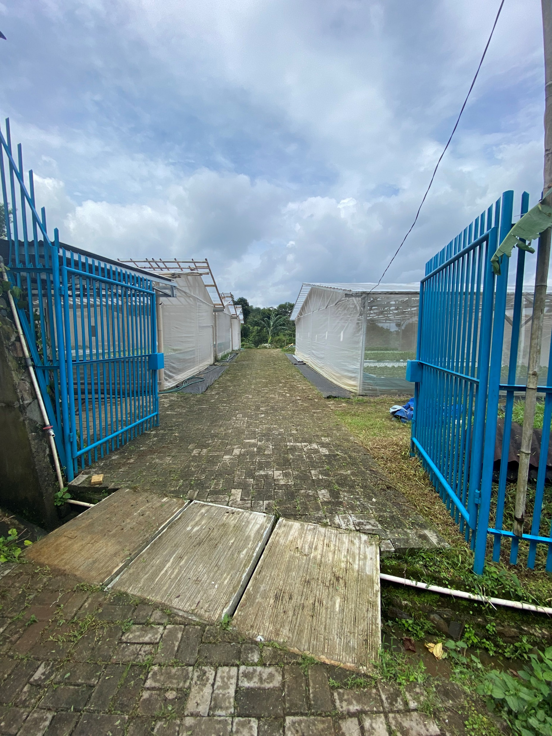
Current Process
So, what’s the problem?
It’s a lack of scalability.
Current operations are relatively small. Allows for their inefficient processes to be tolerated.
They have a large land and currently only use a tiny portion of it. They wish to expand.
Expansion will expose the drawbacks of their current processes.
A scalable solution is needed.
Notes:
So, in summary, what is the problem?
<Read three points, paraphrase.>
Because they (current processes) are not scalable.
And so, a scalable solution is needed.

Slide 10
Objectives
02
Research Questions – Aims & Benefits

Slide 11
Research Questions
Is it possible to devise an Arduino-based and cloud powered solution to track changes in a hydroponic plantation’s environmental factors?
Is it possible for the Arduino device to communicate the data it collected into a database without a need for direct involvement from the staff during day-to-day operations?
Is it possible to create a web application that can automatically compile the information collected from the Arduino and present it in an easy-to-understand manner?
Notes:
This is subject to change or augmentation in the future, but there are currently three research questions.

Slide 12
Aims & Benefits
Aims
*Important to note that there has been minor changes to this section compared to the original report.
The aim of this case study is to create a proof of concept of a hydroponic farm environment monitoring system using an Arduino-based sensor device and a web-based application with the following objectives:
Improving the ease, speed, efficiency, and effectiveness of the hydroponics environment data collection in hydroponic farms, and to a greater extent, Just Hydroponics.
Migrating the method of environment data collection from a manual process to an automated approach utilizing electronic sensors.
Migrating the data storage means from literal whiteboards to a database.

Slide 13
Aims & Benefits
Intended Benefits
*Important to note that there has been minor changes to this section compared to the original report.
From the results of this case study, I hope that the resultant system can deliver the following improvements to any hydroponic farm:
Increased operational efficiency, to reduce costs.
Achieve a higher degree of consistency through systemization and automation.
Increasing data security and longevity.
Increase the accessibility of data by utilizing a centralized data access system.
Increased response time by drastically increasing the frequency of data collection.

Slide 14
Aims & Benefits
Case Study Findings
*This did not exist in the report originally submitted for pre-defence.
During the creation and execution of this case study, I have made several discoveries which I hope may be of use as a reference material in future research into this field.
Documentation of the ESP8266 Wi-Fi module for Arduino is sparse and are often unreliable. Gathering information on it was rather difficult.
Documentation and discussion on the use of the SoftwareSerial class in the Arduino IDE is also unreliable with almost no citations, leading me to have to experiment to determine how to properly use it.
The nature of the Arduino IDE itself is also not made immediately apparent, being buried deep inside documentation.
I’ve written down whatever knowledge I’ve compiled during the process of writing this case study within the second chapter, which cover theoretical foundation.

Slide 15
Solution
03
Arduino Design – Web Application Design

Slide 16
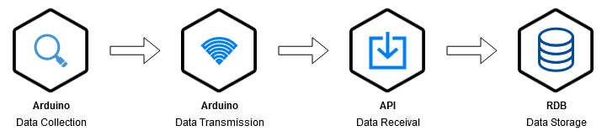
Architecture Overview
Process Cycle
Data is collected by sensors connected to the Arduino device.
The data is then formatted into a $_GET superglobal string and then transmitted via internet to the API.
The data string is received by the web application’s API.
The web application then formats the data into an SQL query to insert the data into the RDB server.

Slide 17
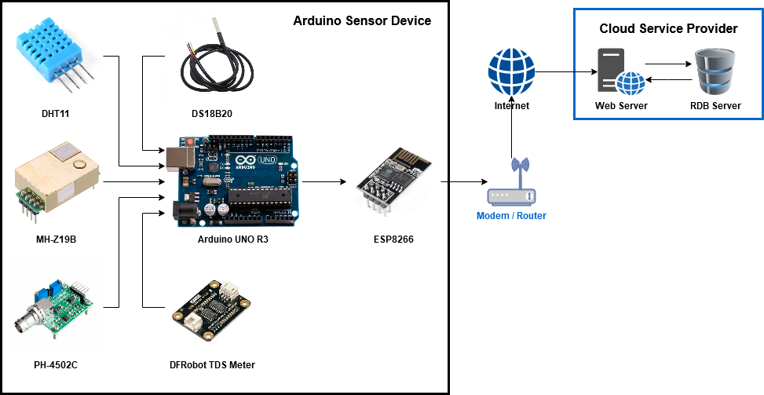
Architecture Overview
Arduino
Five sensors retrieves six variables from the environment.
DS18B20 collects Water Temperature data.
DHT11 collects Air Temperature and Humidity data.
MH-Z19B collects CO₂ data.
PH-4502C collects pH data.
The TDS Meter collects Nutrient TDS data.
The ESP8266 Wi-Fi module transmits data.

Slide 18
Architecture Overview
Web Application - API
The String above illustrates how the sensor data will be transmitted into the API.
Because the web application and the API uses PHP, the data String is formatted to be compliant with PHP’s $_GET superglobal variables.
The data String above is formatted to transmit the following data:
Water Temperature is 21 ºC.
Air Temperature is 24 ºC.
Humidity is 50%.
CO₂ is 1000 ppm.
pH is 6.5.
Nutrient Concentration is 400 ppm.

Slide 19
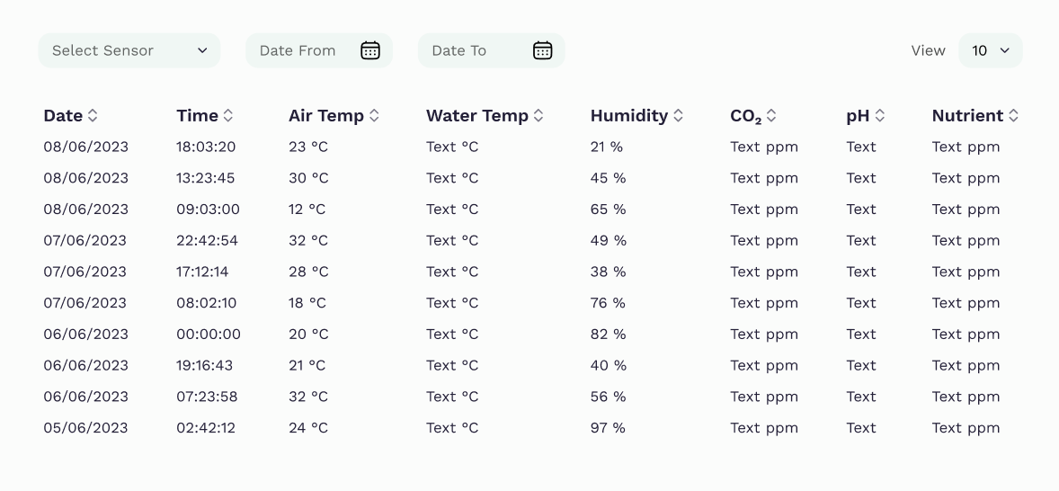
Architecture Overview
Web Application – User Interface
Notes:
This is the UI.
*After done*
Might have noticed that there are little to no details about the web application User interface.
It’s because it’s still largely a work in progress.

Slide 20
Scope
04
Case Study Limitations

Slide 21
Scope
Arduino
The capability of the device will be strictly limited to monitoring environmental variables. It will not be able to perform any actions that can directly influence the hydroponic farm.
The environmental variables stated in point (a) will be limited to six:
Water Temperature
Air Temperature
Humidity
CO₂ Levels
pH Levels
Nutrient Levels

Slide 22
Scope
Web Application
In its role as a terminal for users, the web application will have a user interface.
The user interface will be able to display data collected from the Arduino.
The user interface will have a feature that allows the user to display data from a specific selected sensor.
The user interface will also have a feature that allows the user to filter data based on a range of time.
In its role as a receiver for data from the Arduino, the web application will include a URL-based API for the Arduino to access.
The data will be passed on via PHP’s $_GET super global variable passed by URL.
The data will then be processed by the API code and be automatically inserted into the database.

Slide 23
Scope
Web Application
As a rudimentary website that features neither valuable data nor features that can be a security risk to the hydroponic farm, the security feature of the website will be limited to a simple password. Individual user accounts are deemed to be unnecessary, as the website will not feature differing access levels/tiers.
Due to the simple nature of the web application, for ease of development due to the limited time and resources, it will be developed using the base PHP 8. It will not utilize any frameworks.
Notes:
Before we move on from scope, there are some important things to note that I haven’t included in the SCOPE just yet, because it’s new.
I’ve mentioned that the scope is here to define the limitations of the case study, because my skillsets are limited.
Due to this limitation, this case study will not include:
A commercial viability study. It’s purely a scientific and technical.
A hardware durability study. I don’t have the necessary expertise to design a durable hardware.

Slide 24
What Comes Next
05
Improvements – Changes – Implementation – Evaluation

Slide 25
What Comes Next?
My plans after the pre-defence.
Still some incomplete parts in chapters 2 – 4.
(2) Theoretical foundation for the ESP8266.
(3) Current processes.
(4) Arduino final schematics.
Do chapters 5 – 7.
Implement your suggested changes.
Many of these parts are basically already done, but with foreseeable minor changes, I felt it pointless to put it in the report only to remove / replace them repeatedly.
Notes:
On the last point-> Abstraction, not in a presentable state!

Slide 26
THANK YOU
c

